Slide 1
Job Market Analysis
Pruthviraj V Mariguddi (Individual)
Project team id : PTID-CDA-DEC-25-1097
Project code: PRDA-04

Slide 2
Task 1 Overview
Task 1: Data Extraction from Database
For this project, the data was extracted from a relational database using the provided database credentials. A secure connection was established to the database, and the required job market dataset was queried from the relevant tables. The extracted data included information such as job titles, company details, locations, salary ranges, industries, skills, and education requirements. The data was then exported and loaded into Excel/Power BI for further cleaning, transformation, and analysis.

Slide 3
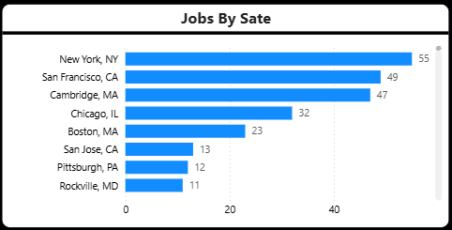
Task 2 Overview
Task 2: States with Most Number of Jobs
This analysis identifies the states with the highest number of job postings. Using job location data, job counts were aggregated state-wise to understand regional hiring demand. The results show that certain states such as New York, California, and Massachusetts have a significantly higher concentration of job opportunities, indicating major hiring hubs for data-related roles.

Slide 4
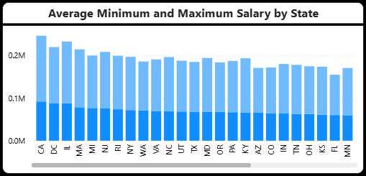
Task 3 Overview
Task 3: Average Minimal and Maximal Salaries in Different States
This task compares the average minimum and maximum salary ranges across different states. By analyzing salary boundaries state-wise, the visualization highlights how compensation varies geographically. Some states offer wider salary ranges, reflecting differences in cost of living, demand, and industry presence.

Slide 5
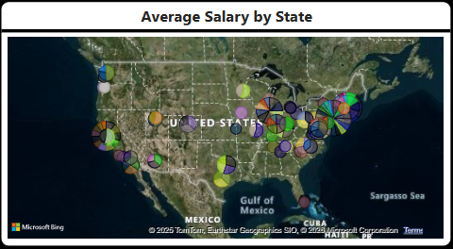
Task 4 Overview
Task 4: Average Salary in Different States
The average salary by state analysis provides insight into how overall compensation differs across locations. Using average salary values, this visualization helps identify high-paying states and regions. The geographic map further supports this analysis by showing the spatial distribution of salary levels across the United States.

Slide 6
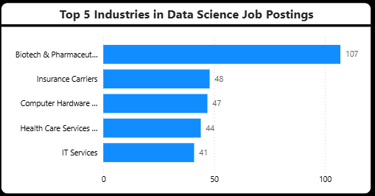
Task 5 Overview
Task 5: Top 5 Industries with Maximum Number of Data Science Related Job Postings
This analysis focuses on identifying the industries with the highest demand for data science-related roles. By filtering data science job titles and aggregating job counts by industry, the results show that industries such as Biotech & Pharmaceuticals, Insurance, and IT Services are among the top recruiters, indicating strong industry-driven demand for data professionals.

Slide 7
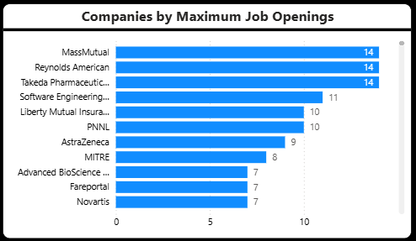
Task 6 Overview
Task 6: Companies with Maximum Number of Job Openings
This task highlights companies that have posted the highest number of job openings. By aggregating job postings at the company level, the analysis identifies organizations that are actively hiring and investing in data-driven roles. These companies represent major employment opportunities within the job market.

Slide 8
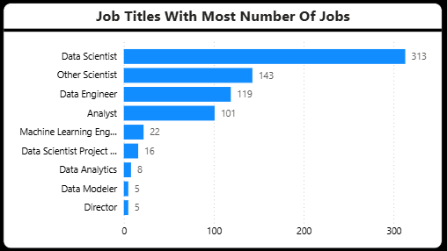
Task 7 Overview
Task 7: Job Titles with Most Number of Jobs
This analysis examines which job roles are most in demand across the dataset. By counting job postings for each standardized job title, roles such as Data Scientist, Data Engineer, and Data Analyst emerge as the most frequently advertised positions, reflecting current market demand for these skill sets.

Slide 9
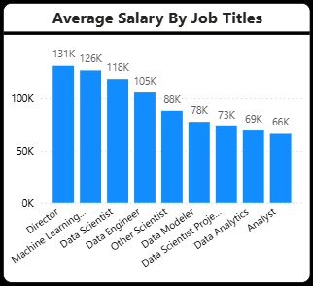
Task 8 Overview
Task 8: Salary of Job Titles with Most Number of Jobs
This task analyzes the average salary associated with the most in-demand job titles. By combining job count and salary data, it provides insights into the compensation levels of popular roles. The analysis shows that while some roles offer higher salaries, others provide more job opportunities, highlighting a trade-off between demand and pay.

Slide 10
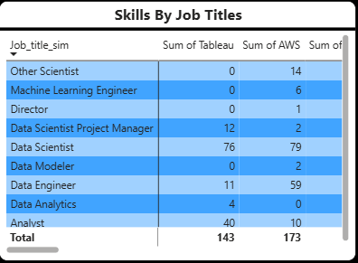
Task 9 Overview
Task 9: Skills Required by Companies for Each Job Title
This analysis identifies the key technical skills required for different job roles. By aggregating skill indicators (such as Python, SQL, AWS, Tableau) by job title, the results show clear skill patterns across roles. This helps understand which skills are essential for specific positions in the job market.

Slide 11
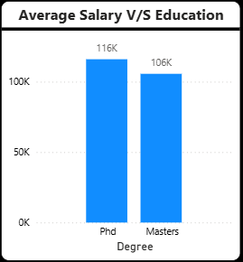
Task 10 Overview
Task 10: Relation between Average Salary and Education
This task explores the relationship between education level and average salary. By comparing salaries across different education categories, the analysis indicates that higher education levels generally correlate with higher average salaries, although many job postings do not explicitly specify education requirements.

Slide 12
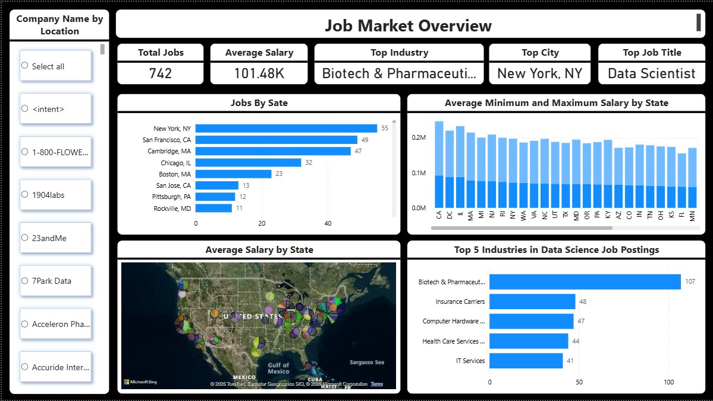
Dashboard pg. 1

Slide 13
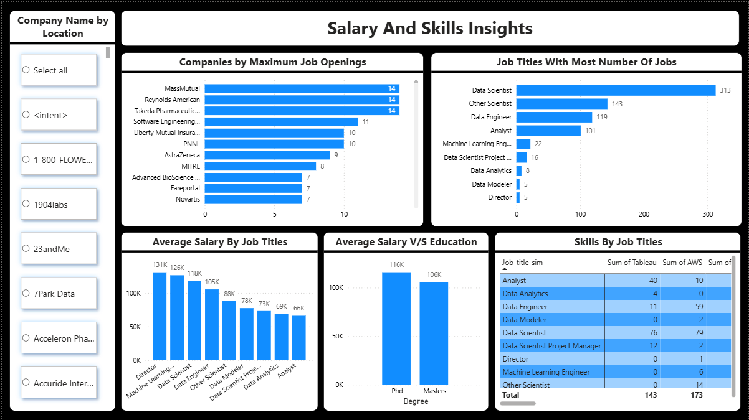
Dashboard pg. 2

